Slide 1
Introduction to Clustering

Slide 2
What is clustering?
It is unsupervised learning method.
It is a process of groping objects together into clusters based on their similarity or dissimilarity.
Its main goal is to minimize the intra cluster distance and to maximize the inter cluster distance.
A distance function is used to determine a measure of dissimilarity between two given objects.
How is it similar to classification?
In both the processes, objects are assigned to certain groups.

Slide 3
How is it different from classification?
It is unsupervised learning
It uses unlabeled dataset
Number, size and shape of clusters not known initially
It is used for descriptive analysis
Types of clustering algorithms
Partitioning based
Hierarchical
Density based
Distribution based
Fuzzy clustering

Slide 4
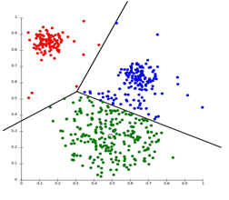
Types of Clustering Algorithms
Partitioning based
Given a set of n objects, this type of algorithms, decompose the set into k clusters such that
K<=n
No two clusters overlap
No cluster is empty
K-means, K-medoids algorithms

Slide 5
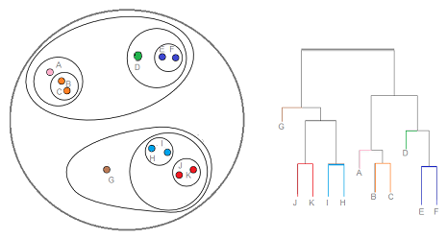
Types of Clustering Algorithms
Hierarchical
A tree structure (hierarchy) is to used to represent the clusters being created and the clustering process.
There are two types
Top-down (Divisive) – BIRCH algorithm
Bottom-up (Agglomerative) – MST clustering algorithm

Slide 6
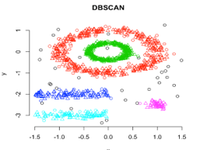
Types of Clustering Algorithms
Density based
Regions with various levels of density are declared as clusters.
They can create clusters with non-convex shape.
DBSCAN algorithm

Slide 7
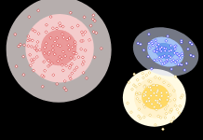
Types of Clustering Algorithms
Distribution model based
If distribution model of the objects is known then this type of algorithms can be used.
Expectation-Maximization (EM) algorithm

Slide 8
Types of Clustering Algorithms
Fuzzy clustering
In this type of clustering, each object doesn’t exactly belong to one cluster.
Each object belongs to all the clusters with varying probabilities.
It is also called soft clustering.
Fuzzy C-means (FCM) algorithm.

Slide 9
Types of Variables
Nominal variables
Values of such variables represent some kind of category, code or state.
Also called categorical variables.
Values don’t have any specific built-in order.
Color of a car, marital status
Most of the mathematical operations such as mean, median, mode, etc are meaningless for such variables.

Slide 10
Types of Variables
Binary variables
They are nominal variables with only two possible states or categories.
They are of two types
Symmetric – if both the states are equally important, for example, gender in student dataset
Asymmetric – if both the states have different importance, for example, a medical test with two possible states: positive & negative

Slide 11
Types of Variables
Ordinal variables
Values have a meaningful order or ranking among them, but the magnitude between the successive values is not known.
Drink-size, performance grade
Mathematical operations such as median & mode are useful but mean, addition, etc are meaningless
Nominal, binary and ordinal variables are qualitative.

Slide 12
Types of Variables
Numeric variables
They are quantitative and measurable quantities represented by integers or real numbers.
Age, height, weight, temperature, account balance
They are of two types
Interval scaled – they are measurements on a scale of equal size units. The values have order and can be +ve or –ve, for example, temp.
Ratio scaled – they have inherent zero point. Value can be specified as multiple or ratio of another value, for example, weight

Slide 13
Distance Measures
Used to determine dissimilarities between the objects in the dataset.
The calculated dissimilarities are represented using a matrix structure called distance matrix or adjacency matrix or dissimilarity matrix
 | 1 | 2 | 3 | 4 | 5
1 | 0
2 | D(2,1) | 0
3 | D(3,1) | D(3,2) | 0
4 | D(4,1) | D(4,2) | D(4,3) | 0
5 | D(5,1) | D(5,2) | D(5,3) | D(5,4) | 0

Slide 14


Distance Measures
For Nominal variables
Given two objects i & j with p variables, distance can be calculated as, $D\left(i,j\right)=\frac{p−m}{p}$, where m is number of variables for which i & j are in the same state.
$$D\left(2,1\right)=\frac{2−0}{2}=1$$
PID | Marital status | Nationality
1 | Married | Indian
2 | Single | French
3 | Divorced | American
4 | Married | Indian
5 | single | American
0
1 | 0
 |  | 0
 |  |  | 0
 |  |  |  | 0

Slide 15
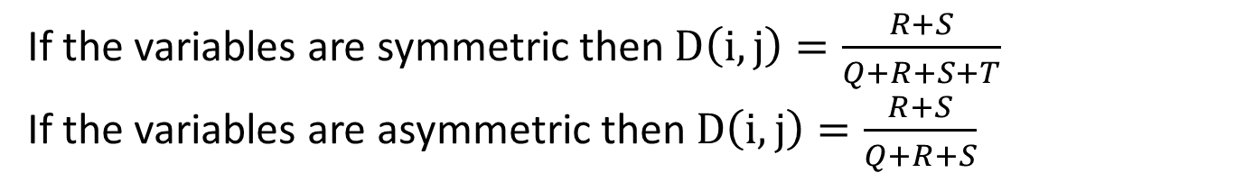
Distance Measures
For Binary variables
Given two objects i & j with p variables, distance can be calculated as follows.
Where,
Q is number of variables for which both objects i & j are in state 1
R is number of variables for which object i is in state 1 & object j is in state 0
S is number of variables for which object i is in state 0 & object j is in state 1
T is number of variables for which both objects i & j are in state 0
 | Object j
Object i |  | 1 | 0
 | 1 | Q | R
 | 0 | S | T
If the variables are symmetric then $D\left(i,j\right)=\frac{R+S}{Q+R+S+T}$
If the variables are asymmetric then $D\left(i,j\right)=\frac{R+S}{Q+R+S}$

Slide 16
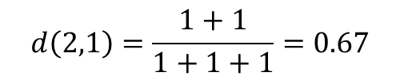
Distance Measures
For example, consider a patient dataset
PID | Fever | Cough | Test1 | Test2 | Test3 | Test4
1 | Y | N | P | N | N | N
2 | Y | Y | N | N | N | N
3 | Y | N | P | N | P | N
PID | Fever | Cough | Test1 | Test2 | Test3 | Test4
1 | 1 | 0 | 1 | 0 | 0 | 0
2 | 1 | 1 | 0 | 0 | 0 | 0
3 | 1 | 0 | 1 | 0 | 1 | 0
 | Object 2
Object 1 |  | 1 | 0
 | 1 | 1 | 1
 | 0 | 1 | 3
0
0.67 | 0
 |  | 0
$$d\left(2,1\right)=\frac{1+1}{1+1+1}=0.67$$

Slide 17
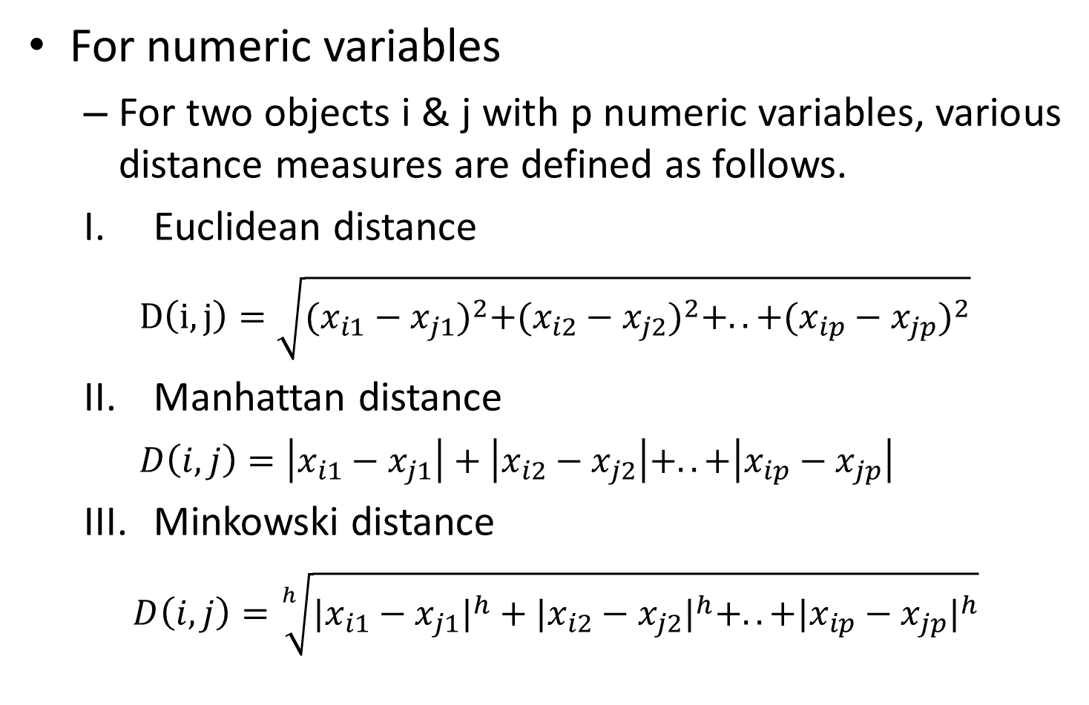
Distance Measures
For numeric variables
For two objects i & j with p numeric variables, various distance measures are defined as follows.
Euclidean distance
$D\left(i,j\right)=\sqrt{{(x_{i1}−x_{j1})}^{2}+{(x_{i2}−x_{j2})}^{2}+..+{(x_{ip}−x_{jp})}^{2}}$
Manhattan distance
$D\left(i,j\right)=\left|x_{i1}−x_{j1}\right|+\left|x_{i2}−x_{j2}\right|+..+\left|x_{ip}−x_{jp}\right|$
Minkowski distance
$D\left(i,j\right)=\sqrt[h]{{|x_{i1}−x_{j1}|}^{h}+{|x_{i2}−x_{j2}|}^{h}+..+{|x_{ip}−x_{jp}|}^{h}}$

Slide 18

Distance Measures
For numeric variables
Supremum distance
$D\left(i,j\right)=\max_{f}\left|x_{if}−x_{jf}\right| over p variables$
For example, x1=(1,2) & x2=(3,5)

Slide 19
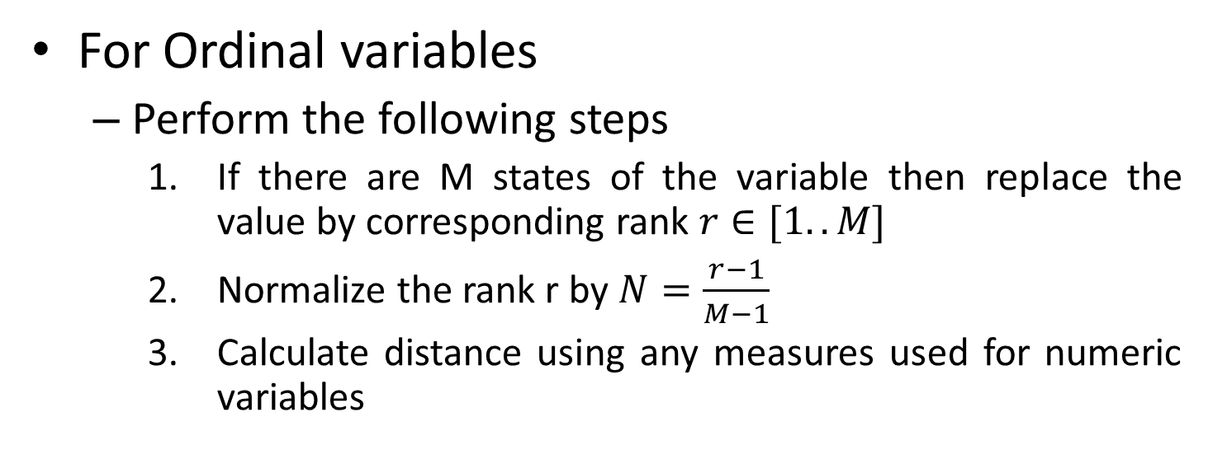
Distance Measures
For Ordinal variables
Perform the following steps
If there are M states of the variable then replace the value by corresponding rank $r∈[1..M]$
Normalize the rank r by $N=\frac{r−1}{M−1}$
Calculate distance using any measures used for numeric variables
Roll no | Grade
1 | A
2 | B
3 | C
4 | A
Roll no | Grade
1 | 3
2 | 2
3 | 1
4 | 3
Roll no | Grade
1 | 1
2 | 0.5
3 | 0
4 | 1
0
0.5 | 0
 |  | 0
 |  |  | 0

Slide 20
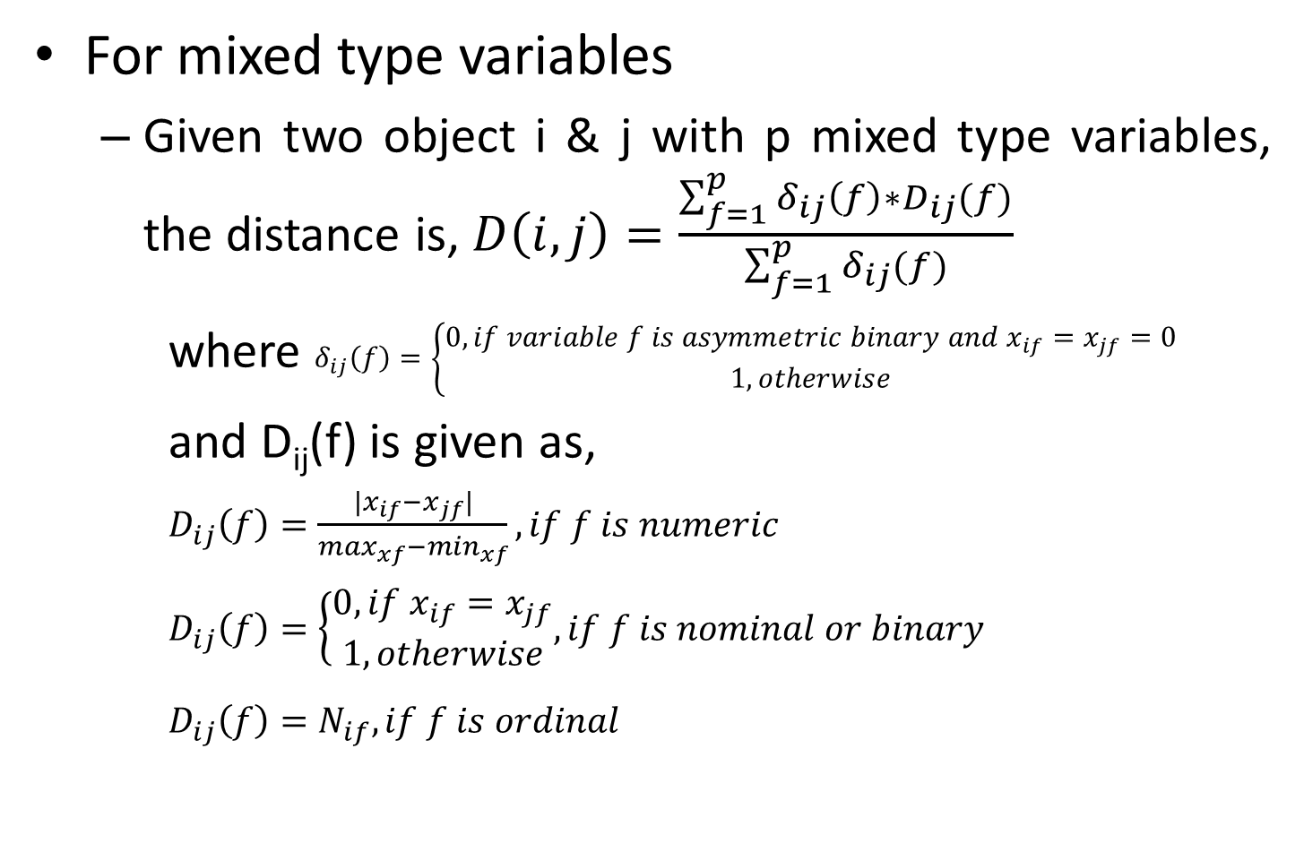
Distance Measures
For mixed type variables
Given two object i & j with p mixed type variables, the distance is, $D\left(i,j\right)=\frac{\sum_{f=1}^{p}{δ_{ij}\left(f\right)∗D_{ij}(f)}}{\sum_{f=1}^{p}{δ_{ij}(f)}}$
where $δ_{ij}\left(f\right)=\left\{\begin{aligned}0, if variable f is asymmetric binary and x_{if}=x_{jf}=0 \\ 1, otherwise\end{aligned}\right.$
and D_{ij}(f) is given as,
$D_{ij}\left(f\right)=\frac{|x_{if}−x_{jf}|}{\max_{xf}−\min_{xf}}, if f is numeric$
$D_{ij}\left(f\right)=\left\{\begin{aligned}0, if x_{if}=x_{jf} \\ 1, otherwise\end{aligned}, if f is nominal or binary\right.$
$D_{ij}\left(f\right)=N_{if}, if f is ordinal$

Slide 21

Distance Measures
ID | Var1 | Var2 | Var3
1 | S1 | Excellent | 45
2 | S2 | Good | 22
3 | S3 | Fair | 64
4 | S1 | Good | 28
Var1 | 1 | 2 | 3 | 4
1 | 0
2 | 1 | 0
3 | 1 | 1 | 0
4 | 0 | 1 | 1 | 0
Var2 | 1 | 2 | 3 | 4
1 | 0
2 | 0.5 | 0
3 |  |  | 0
4 |  |  |  | 0
Var3 | 1 | 2 | 3 | 4
1 | 0
2 | 0.55 | 0
3 |  |  | 0
4 |  |  |  | 0
 | 1 | 2 | 3 | 4
1 | 0
2 | 0.68 | 0
3 |  |  | 0
4 |  |  |  | 0
$$D\left(2,1\right)=\frac{\left(1\right)∗\left(1\right)+\left(1\right)∗\left(0.5\right)+\left(1\right)∗(0.55)}{1+1+1}=0.68$$

Slide 22
Exercise
Given two objects A=(22,1,42,10) & B=(20,0,36,8), determine Euclidean distance, Manhattan distance, Minkowski distance (h=3) & Supremum distance between them.
Calculate adjacency matrix for the given dataset.
PID | Height | Weight | Hair color | Complexion | Gender | Marital status
1 | 2.1 | 82.5 | Black | Dark | Male | Married
2 | 1.7 | 71.6 | Black | Fair | Male | Single
3 | 1.9 | 78.9 | Brown | Fair | Female | Married
4 | 1.8 | 75.2 | Blond | White | Male | Divorced

Slide 23
K-means clustering
centroid based partitioning approach to clustering.
Input: the set of objects and number of clusters k
K-means (set of objects, number of clusters k)
Select k objects arbitrarily as initial cluster centroids;
Assign/reassign each object to the cluster to which the object is closest based on its distance from the cluster centroid;
Update the cluster centroids;
Repeat steps (2) & (3) until there is no change.

Slide 24
K-means clustering
Consider a dataset D={22, 9, 12, 15, 10, 27, 35, 18, 36, 11}. Create 3 clusters using k-means clustering
Cluster | Objects | Centroids
1 | 22 | 22
2 | 9 | 9
3 | 12 | 12
Cluster | Objects | Centroids
1 | 22, 27, 35, 18, 36 | 27.6
2 | 9, 10 | 9.5
3 | 12, 15, 11 | 12.6
Cluster | Objects | Centroids
1 | 22, 27, 35, 36 | 30
2 | 9, 10, 11 | 10
3 | 12, 15, 18 | 15

Slide 25
K-means clustering
D={22, 9, 12, 15, 10, 27, 35, 18, 36, 11}
Cluster | Objects | Centroids
1 | 22, 27, 35, 36 | 30
2 | 9, 10, 11 | 10
3 | 12, 15, 18 | 15
Cluster | Objects | Centroids
1 | 27, 35, 36 | 32.6
2 | 9, 12, 10, 11 | 10.5
3 | 22, 15, 18 | 18.3
Cluster | Objects | Centroids
1 | 27, 35, 36 | 32.6
2 | 9, 12, 10, 11 | 10.5
3 | 22, 15, 18 | 18.3

Slide 26
Hierarchical clustering
A tree structure called Dendrogram is used to specify the clustering process & the clusters being created.
The root of the Dendrogram is a single clusters with all the objects in it whereas the leaf nodes consist of single element clusters.
Each level of Dendrogram is associated with a distance threshold which was used to form clusters at that level.
There are two approaches
Top down (Divisive): Starts with a single cluster which is iteratively subdivided into smaller clusters.
Bottom up (Agglomerative): Starts with each object in its own cluster and clusters are iteratively merged to form higher level larger clusters.

Slide 27
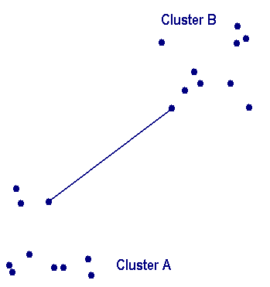
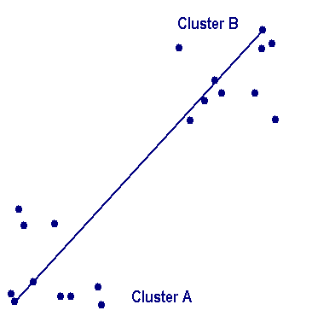
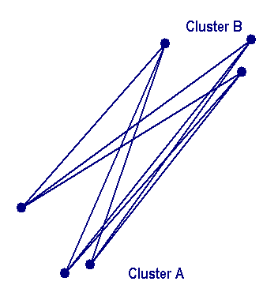
Hierarchical clustering
Bottom up hierarchical clustering
There are three variations, depending up on how the distance between the clusters is calculated.
Single linkage, Complete linkage & Average linkage
Top down hierarchical clustering
In each iteration, one of the existing clusters is selected for split
The split is performed such that the error is minimized

Slide 28
Hierarchical clustering
Food item | Protein | fat
1 | 1.1 | 60
2 | 8.2 | 20
3 | 4.2 | 35
4 | 1.5 | 21
5 | 7.6 | 15
6 | 2 | 55
7 | 3.9 | 39
 | 1 | 2 | 3 | 4 | 5 | 6 | 7
1 | 0
2 | 40.63 | 0
3 | 25.19 | 15.24 | 0
4 | 39 | 6.77 | 14.26 | 0
5 | 45.47 | 5.03 | 20.27 | 8.56 | 0
6 | 5.08 | 35.54 | 20.12 | 34 | 40.39 | 0
7 | 21.19 | 19.48 | 4.01 | 18.16 | 24.29 | 16.11 | 0
 | 1 | 2 | 3,7 | 4 | 5 | 6
1 | 0
2 | 40.63 | 0
3,7 | 21.19 | 15.24 | 0
4 | 39 | 6.77 | 14.26 | 0
5 | 45.47 | 5.03 | 20.27 | 8.56 | 0
6 | 5.08 | 35.54 | 16.11 | 34 | 40.39 | 0
4.01
1 2 3 4 5 6 7 0

Slide 29
Hierarchical clustering
 | 1 | 2,5 | 3,7 | 4 | 6
1 | 0
2,5 | 40.63 | 0
3,7 | 21.19 | 15.24 | 0
4 | 39 | 6.77 | 14.26 | 0
6 | 5.08 | 35.54 | 16.11 | 34 | 0
5.03
4.01
1 2 3 4 5 6 7 0
 | 1,6 | 2,5 | 3,7 | 4
1,6 | 0
2,5 | 35.54 | 0
3,7 | 16.11 | 15.24 | 0
4 | 34 | 6.77 | 14.26 | 0
5.08
5.03
4.01
1 2 3 4 5 6 7 0

Slide 30
Hierarchical clustering
6.77
 | 1,6 | 2,5,4 | 3,7
1,6 | 0
2,5,4 | 34 | 0
3,7 | 16.11 | 14.26 | 0
5.08
5.03
4.01
1 2 3 4 5 6 7 0
16.11
14.26
14.26
6.77
6.77
5.08
5.08
5.03
 | 1,6 | 2,5,4,3,7
1,6 | 0
2,5,4,3,7 | 16.11 | 0
5.03
4.01
4.01
1 2 3 4 5 6 7 0
1 2 3 4 5 6 7 0

